Slide 1

SINCA - Scientific Calculator
By Shivangini
Engineered for Accuracy

Slide 2
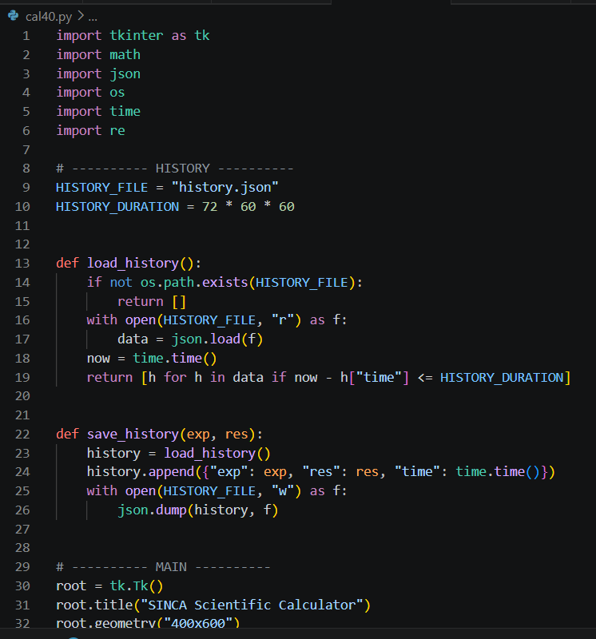
Introduction
Initially, I was asked to design a basic calculator. However, while working on it, I explored more about GUI development and realized that I could extend this project further. So instead of limiting it to basic operations, I developed a scientific calculator.
I chose Tkinter for this project because it is built-in with Python, easy to use for GUI development and suitable for small-scale applications.
Although there are other libraries like PyQt, Kivy and so on, but I found Tkinter more simple and faster for my implementation.

Slide 3

Libraries
Beyond the UI, I integrated several standard libraries to power the backend logic:
math for handling complex scientific functions.
json and os for data persistence and local file
handling.
re and time for advanced input parsing and
managing real-time processes.

Slide 4
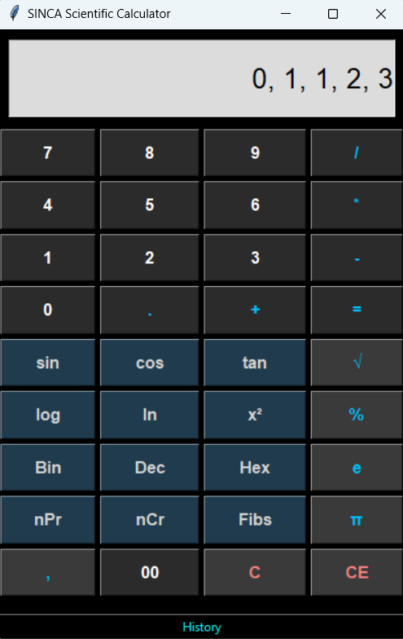
Features & Design Approach
While designing this calculator, I included all the basic operations like addition, subtraction, multiplication, and division. Apart from that, I added scientific functions such as sin, cos, tan, log, ln and so on.
I also included some additional features like nPr, nCr, Fibonacci series, number system conversions (Binary, Decimal, Hex), percentage calculation, and a history feature (last 72 hours). My main focus was not to overcrowd the calculator with too many operations, but to keep it simple and include only those functions which are useful in day-to-day operations.

Slide 5

Challenges & Learning
While building this application, I faced several challenges. One of the major challenges was implementing the correct percentage logic similar to a real calculator. I also faced issues with handling keyboard inputs and managing different operations together.
I solved these problems by referring to Python documentation, online resources and debugging, and a trial-and-error approach. This project helped me improve my problem-solving skills and gave me a better understanding of GUI development and event handling.

Slide 6
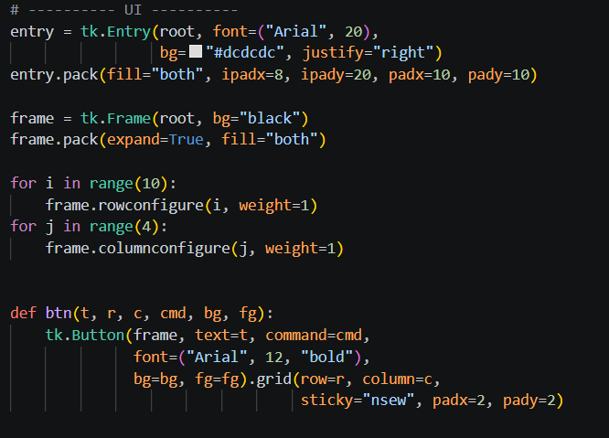

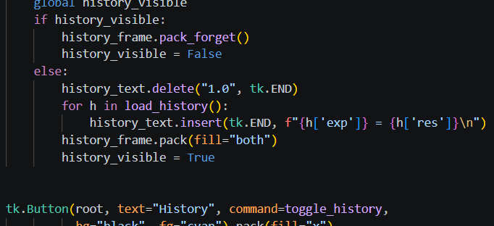
Conclusion
I conclude that, while building this application, my main focus was on both design and functionality. I ensured that the calculator is easy to use and supports both mouse and keyboard interactions.
This calculator can help users perform their daily calculations efficiently in a simple and user-friendly way.
In the future, I can further enhance it by adding features like graph plotting and improving the overall user interface.

Slide 7


Thank you

